Slide 1
Knights Tour

Slide 2
Students
Daniel Matar (219065161)
Amulya Gyawali (219365275)
Devesh Yuvi Juggiah (219378203)
Ramandeep Kaur (218676476)
Bella Chhour (218620536)

Slide 3
INTRODUCTION/OVERVIEW
Knights Tour
In this task you are to create a piece of software that can solve the Knight’s Tour problem on an 𝑁𝑁 × 𝑁𝑁 board. You may select any 𝑁𝑁, and ideally demonstrate a solution for different values of 𝑁𝑁. A good starting point would be the standard 8 × 8 board, although a 6 × 6 board may be easier, depending on the solution method you choose.

Slide 4
Knights Tour Problem
1
Amulya and Bella

Slide 5
Knights Tour Problem
Knights Tour
The knights tour problem is one example of the Hamiltonian Path, a graph theory. Challenges that come with this problem, is deciding on how to solve it. It can be solved in linear time thus we can backtrack (A algorithmic paradigm that computes many different solutions until the solution is found) (Geeks, 2020). This allows us to use any size board up to 8x8.

Slide 6
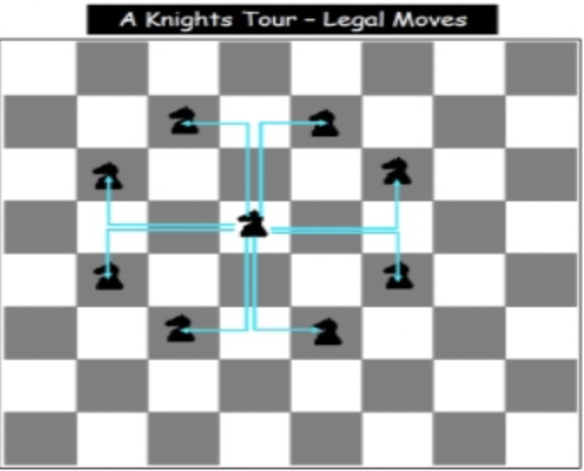
Knights Tour Problem (cont.)
On a chessboard, a Knight’s tour is a series of moves in which the Knight crosses each square precisely once according to the rules of chess. The tour is closed if the Knight finishes on a square one Knight’s move from the beginning square, otherwise, if it finishes anywhere else then it is open.[1]
Only cycle tours are accepted and there is not any difference between a tour and its reverse.
Knights’ legal moves in 8 by 8 chessboard.
Figure 1 (Senanayake, 2011)

Slide 7
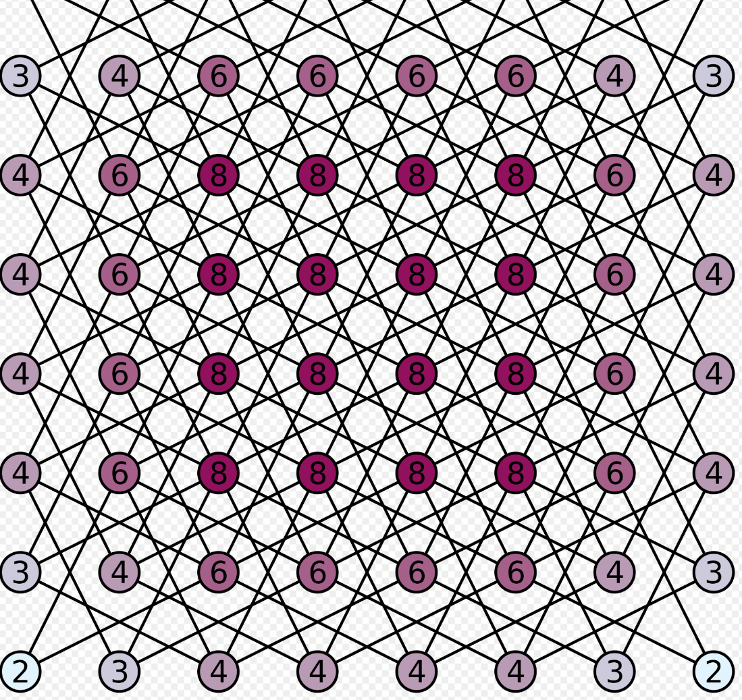
Knights Tour Problem (cont.)
Knight’s tour can be represented as a graph. The vertices represent the square of the board and the edges represent a knight’s legal moves between squares.
Graphical representation
Figure 2 (Wikipedia, 2021)

Slide 8
Algoritm and Solution
2
Daniel, Ramandeep, Devesh, Bella and Amulya

Slide 9
Algoritm and Solution
Backtracking and Brute-force
Backtracking solves problems with a brute force approach, removing any solutions that fail to solve the problem.
Using the DFS (Depth-First Search) method, it branches from move to move checking if this meets the constraints.
Continuing if it does and removing the branch if it does not, returning to the branch before.

Slide 10
Algoritm and Solution (cont.)
Backtracking and Brute-force
Brute Force Search is general problem-solving technique and for the selected 8 by 8 chess board, there are 4 x 10^51 possible move sequences.
Start moving Knight.
If knight goes to the cell and there is no further cell available (i.e., it has not reached to the solution yet)
Then backtrack and change the path.

Slide 11
Algoritm and Solution (cont.)
Backtracking and Brute-force
Now, check all the available moves from the cell that has the knight and recursively check if it reaches to the solution or not yet.
If it still hasn’t reached to the solution, then again change the path.
Keep track of each move in the matrix.
The matrix itself tells us whether we reached to the solution or not (whether we have covered each cell)

Slide 12
Algoritm and Solution (cont.)
Backtracking and Brute-force
Once all the cells are covered, the value of the last cell must be N*N (if the value is marked from 1 as the steps go up)
For the above step, the value of the last cell in our case should be (8*8 = 64 ideally) but it is 63 because we marked our first step as zero.
Hence, this is the approach that is used in the Knight’s tour problem.
(Wikipedia, 2021)

Slide 13
Algoritm and Solution (cont.)
Pseudocode
If all squares visited
Show solution
Else
Move knight to new square from AvailableMoves, check if next possible move leads to solution, recursively.
If move don’t lead to solution
Remove move from AvailableMoves
Try new Move from AvailableMoves
If no move returns solution
Return false, no possible solution
(Geeks, 2020)

Slide 14


Algoritm and Solution (cont.)
Code
Our solution is coded in Python using Visual Studio Code as the IDE (Integrated Development Environment).
It has five functions, and a few variables.

Slide 15
Algoritm and Solution (cont.)
Code
boardSize – This variable is the board size as an integer.
board – This variable is the board represented as a matrix. It contains all numbers from 0 to 63, which represents a 8x8 chess board.
moveX – This variable is an array which contains all possible moves the piece can go along the x axis ( across) The negative values mean left and positive mean right.
moveY - This variable is an array which contains all possible moves the piece can go along the y axis ( up) The negative values mean down and positive mean up.
Pos – Position will always be 1 at the beginning.
currX – Current x move
curry – Current y move

Slide 16
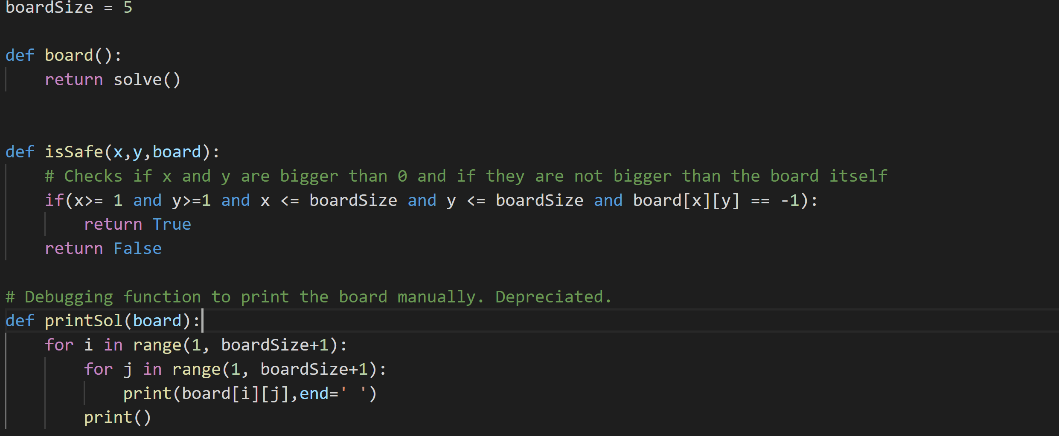
Algoritm and Solution (cont.)
Code
board() – This function passes the solution over to the pygame file that handles the visuals
isSafe(x,y,board) – This function checks whether the move to be taken is within the board dimensions. It takes x, y and board as inputs, which tells it the length and height of the board.
printSol(board) – This function prints the solution once it is found. This is only used for debugging purposes.

Slide 17
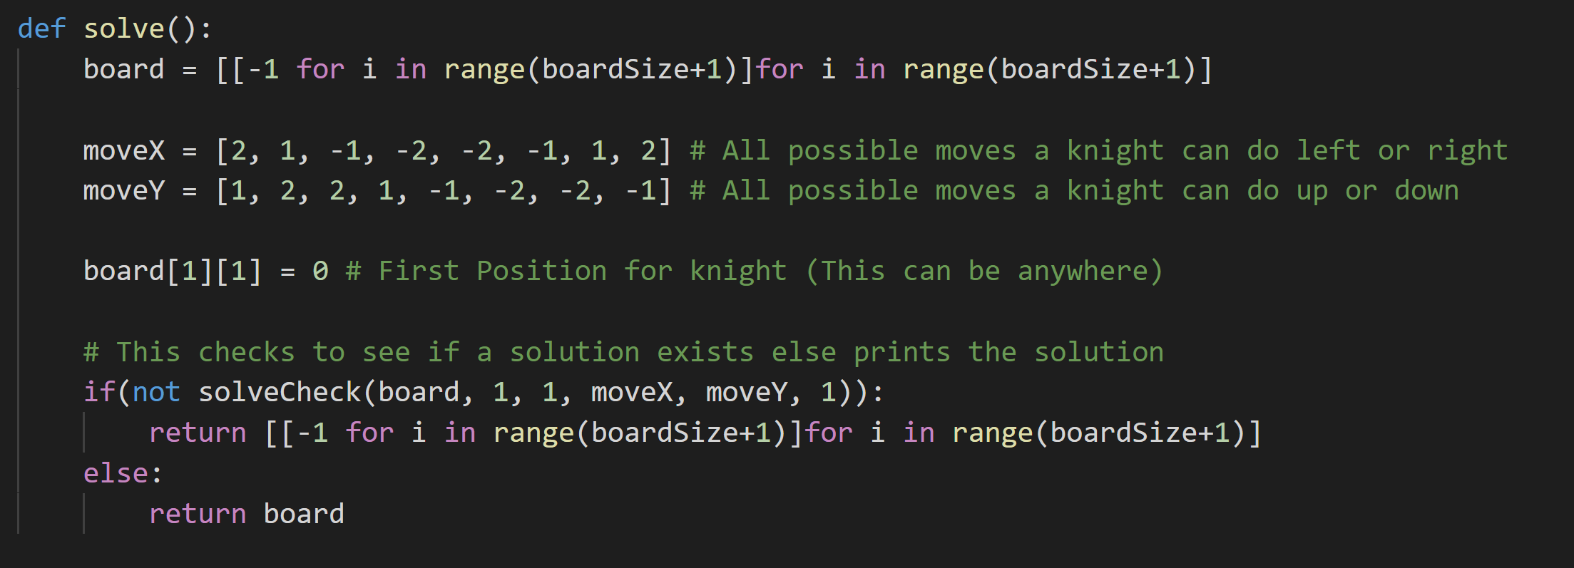
Algoritm and Solution (cont.)
Code
Solve() – This function provides a move to another function SolveCheck(board, x, y, moveX, moveY, pos) which tells us whether it is true or false.

Slide 18
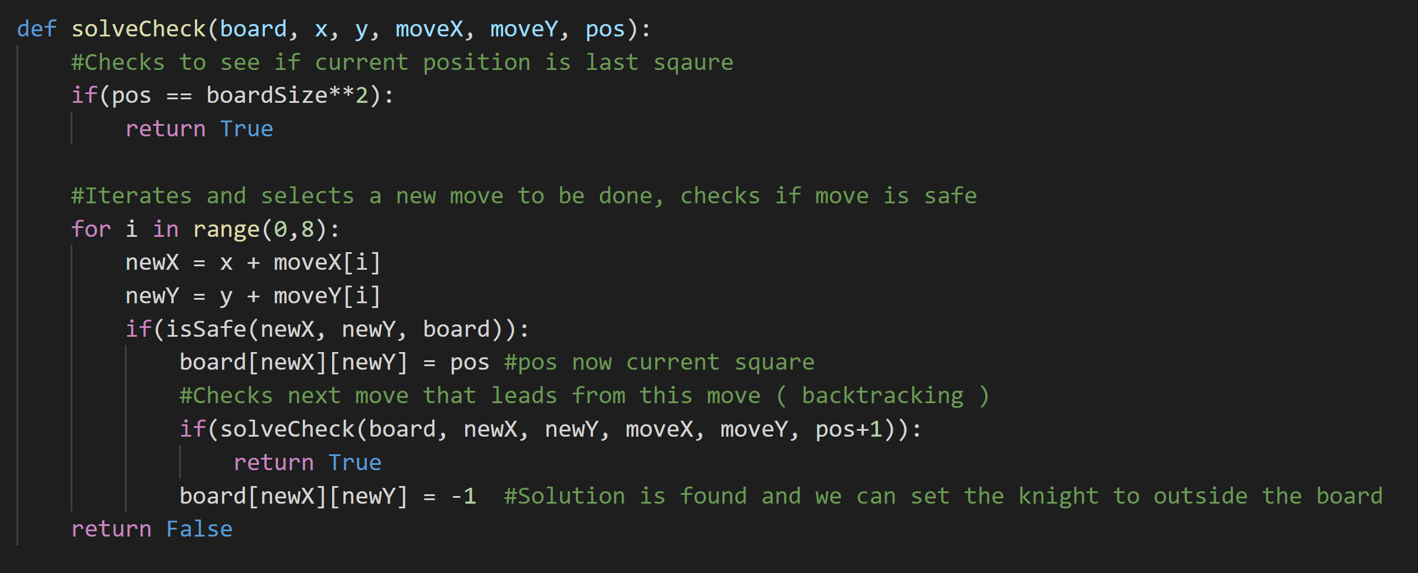
Algoritm and Solution (cont.)
Code
SolveCheck(board, x, y, moveX, moveY, pos) – This function checks whether the move given is true or false. Meaning, it checks if the move is safe. This is the backtracking part of our solution.

Slide 19
Solution Demonstration
3
Daniel

Slide 20
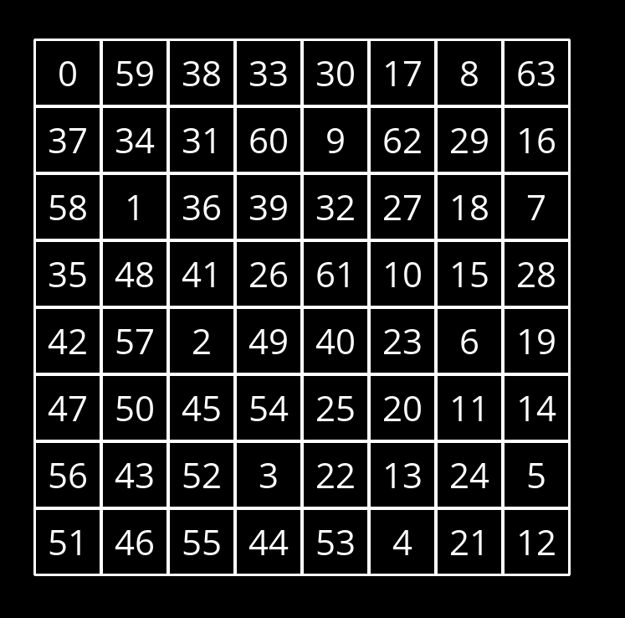
Demonstration
Using Visual Studio Code and Python with Pygame, we can see the path the knight took on a 8 by 8 board.
0 being the first position and 63 being the last.

Slide 21
Learning outcomes
Ramandeep

Slide 22
Learning outcomes
Representation of the legal moves of a knight on a chessboard in a graph
Solved the Knight’s tour problem with the help of visual studio and python
Learned about Backtracking and DFS method

Slide 23
DISCUSSION
4
Daniel

Slide 24
Discussion
What can we do to improve this?
Currently this solution outputs the squares as numbers, which represents in what order did they travel. Though this can be visually represented better, using animations and a faster search method we can watch what moves are taken instead of only seeing the output.
Examples of this are shown in our presentation, going through a few test cases.
We can further improve this by including a proper chessboard layout, chess pieces and a one-by-one square movement.

Slide 25
Reference
Brown, A. J., 2017. San Jose State University. [Online] Available at: https://scholarworks.sjsu.edu/cgi/viewcontent.cgi?article=8383&context=etd_theses [Accessed 19 04 2021].
Datta, S., 2020. Baeldung. [Online] Available at: https://www.baeldung.com/cs/backtracking-algorithms [Accessed 14 April 2021].
De, S., n.d. Code Speedy. [Online] Available at: https://www.codespeedy.com/the-knights-tour-problem-in-python/ [Accessed 14 April 2021].
Field, B., n.d. [Online] Available at: https://bradfieldcs.com/algos/graphs/knights-tour/ [Accessed 14 April 2021].
Geeks, G. F., 2020. Geeks For Geeks. [Online] Available at: https://www.geeksforgeeks.org/the-knights-tour-problem-backtracking-1/ [Accessed 14 April 2021].
Sam, S., 2018. Tutorials Point. [Online] Available at: https://www.tutorialspoint.com/The-Knight-s-tour-problem [Accessed 14 April 2021].

Slide 26
THANKS!

